Slide 1

App Development using Flutter and Dart
Welcome to my internship progress report as App Developer Intern at Sria Infotech, Hyderabad. This presentation covers my individual and team projects, skills gained, and future plans.

Slide 2

Overview of My Work
Mini Projects
Team Projects
Weather App: real-time data display
Loan Desk App: internal loan digitization
Currency Converter: dynamic currency exchange
Big App: apartment data management

Slide 3
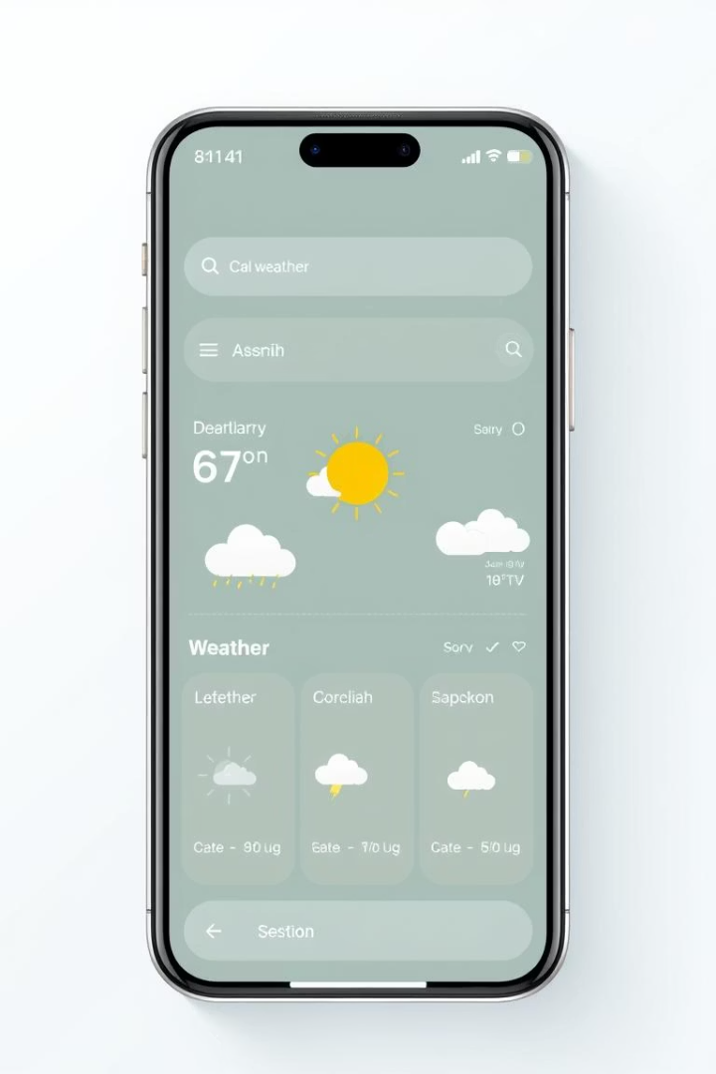
Weather App Development
Technologies Used
Main Features
Real-time updates, city-based weather search
Flutter framework and OpenWeather API integration
Learning Outcomes
Mastered API integration and asynchronous programming

Slide 4

Currency Converter App
Frameworks and APIs
Functionalities
Skills Practiced
Built with Flutter using ExchangeRate API
Currency selection dropdowns and instant conversions
Data fetching and UI structuring techniques

Slide 5




Loan Desk App Contributions
Form Validations
UI Screens
Backend Integration
Designed intuitive user interface pages
Ensured accurate data entry via validation protocols
Connected frontend with backend APIs effectively
Developed teamwork and API communication skills working closely with colleagues.

Slide 6

Main Project: Big App Testing
Testing Responsibilities
Identified bugs and errors rigorously in app modules
Collaboration
Coordinated with backend team for smooth integration
Experience Gained
Enhanced analytical and problem-solving skills

Slide 7


Skills Acquired and Challenges Overcome
Challenges Faced
Technical Skills
Dart complexity mastered by continuous practice
Flutter, Dart, REST APIs
1
2
API understanding through study and team guidance
Git, Firebase, UI/UX design
Debugging
UI responsiveness handled via MediaQuery approaches

Slide 8




Future Goals & Closing Remarks
Skill Enhancement
Advance state management with Provider and Bloc
Project Involvement
Contribute to deployment and comprehensive testing
Responsibilities
Own more complex modules for growth
Thank you for your guidance and support. Looking forward to your questions.

